Slide 1

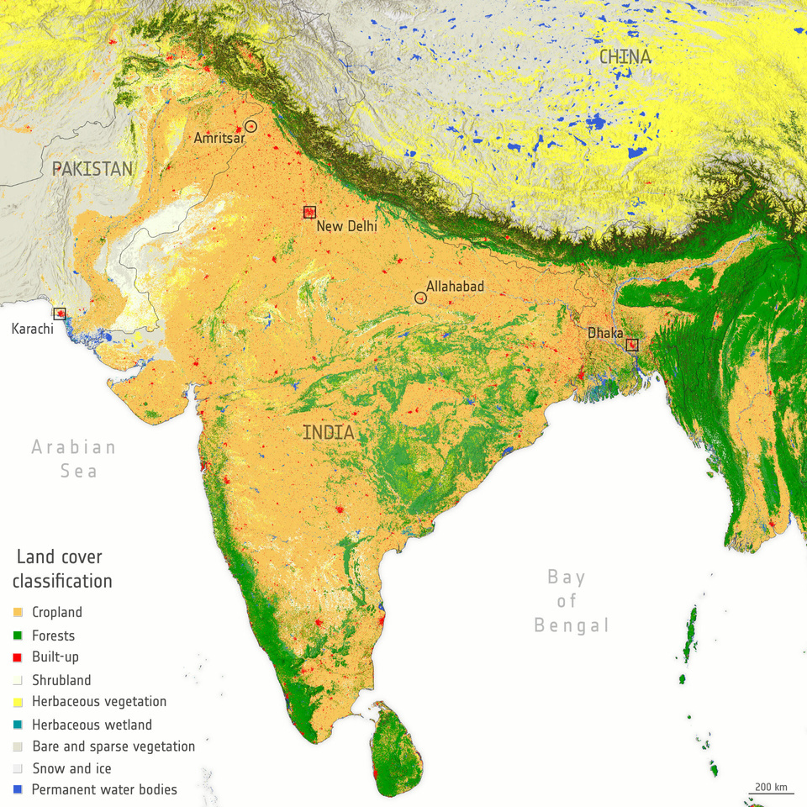
LAND COVER CLASSIFICATION USING MULTI TEMPORAL SATELLITE IMAGES & DOMAIN ADAPTATION
CS300
SUPERVISER : MOUMITA ROY
VASU PANDEY
Batchelor’s of Technology
Indian Institute of Information Technology Guwahati
2101220 | vasu.pandey21b@iiitg.ac.in

Slide 2
TABLE OF CONTENT
Introduction to Project Idea
Objectives & Motivation
Dataset Characteristics
Review of Existing Solutions
DCNN + Attention
Graph CNN
Recurrent CNN
Future Plans
Diffusion Model
Abstract Idea

Slide 3
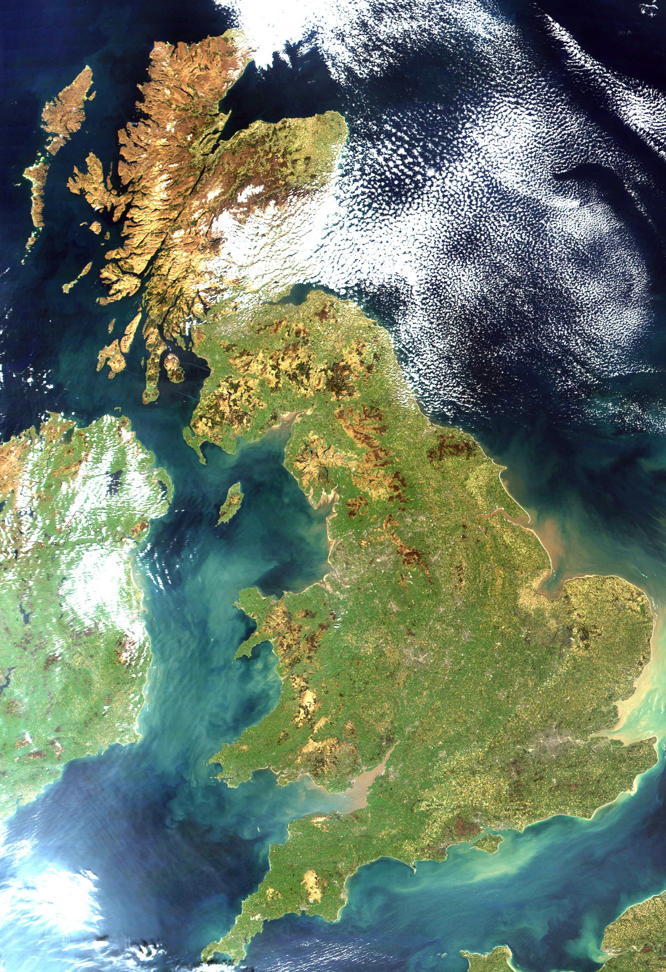
WHAT ?
LAND COVER CLASSIFICATION
Categorizing the Earth's surface features from remotely sensed data, crucial in monitoring the dynamics of the Earth's surface over large areas.
Environmental Monitoring, Urban planning, and Agricultural management.
Annotation of high-resolution images/pixels captured daily by the remote sensing instruments.
Notes:
Categorizing the Earth's surface features from remotely sensed data, plays a crucial role in monitoring the dynamics of the Earth's surface over large areas.
Environmental Monitoring, Urban planning, and Agricultural management.
Deep learning has emerged as the preferred framework
Automatic Feature Extraction: Traditional methods can be time-consuming to design effectively.
High-Level Feature Learning: Deep learning architectures with multiple layers can learn increasingly complex and abstract features from the input data.
Scalability and Generalizability: Deep learning models excel at handling large datasets. Multi-temporal high-resolution images can be voluminous, and deep learning frameworks can efficiently process them.

Slide 4
WHAT & WHY
MULTI TEMPORAL DATA
Images sampled at different points in time for the same geographical location
SITS : Satellite Image Time-Series
Improved Generalizability
Captures the dynamic nature of land cover and becomes less susceptible to variations solely due to seasonal changes within a domain.
Captures Land Cover Dynamics: Monitoring changes over time allows identification of land cover transitions
Deforestation
Urbanization
Course change of water bodies
Improved Discrimination
The model can learn to distinguish land cover types based on their visual & phenological changes
Notes:
Tracks Seasonal Variations: By observing changes in spectral reflectance over time, the model can distinguish land cover types based on their phenology (e.g., differentiating deciduous and evergreen forests).
Improved Discrimination: Seasonal changes in vegetation greenness, snow cover, or water levels can help differentiate land cover types that might appear similar in a single image.
Captures Land Cover Dynamics: Monitoring changes over time allows identification of land cover transitions, such as deforestation or urbanization.
Enhanced Generalizability: The model learns to account for seasonal variations within a domain, making it less susceptible to these changes and potentially improving performance across different seasons.

Slide 5
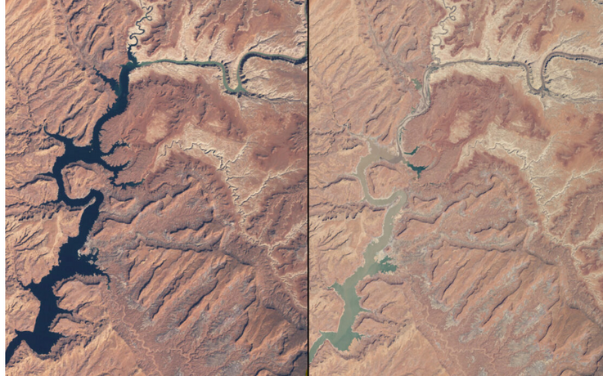
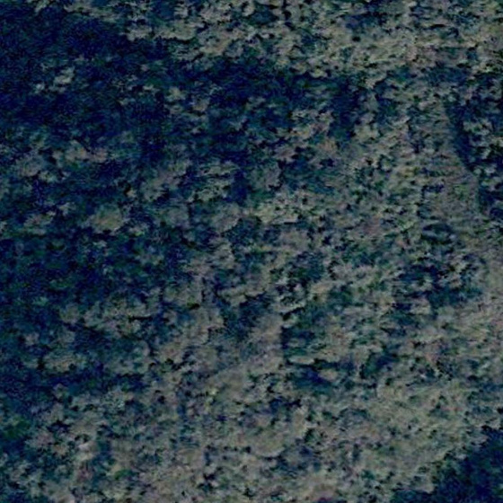
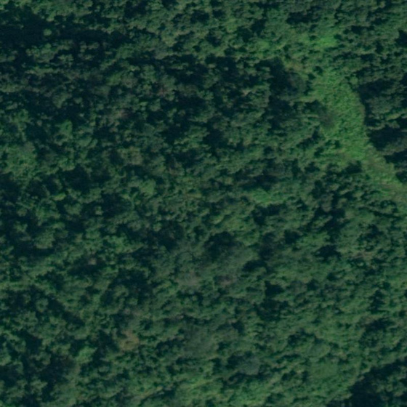
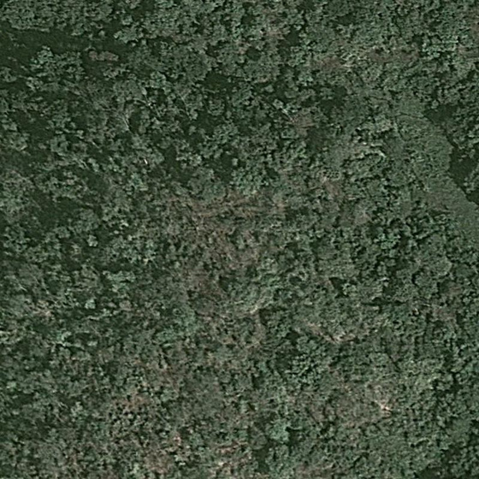
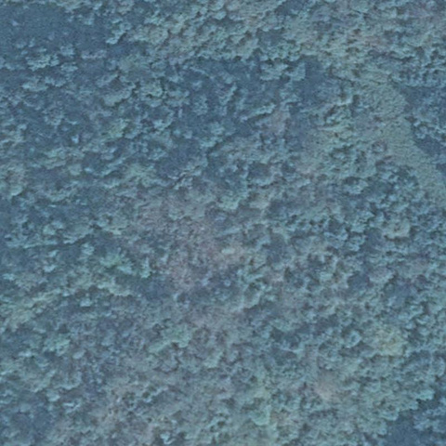
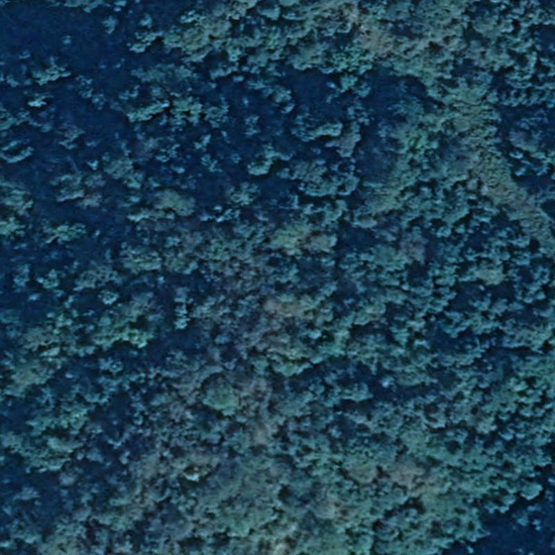
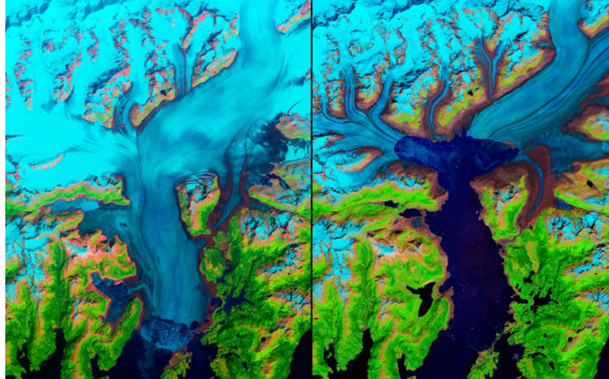
MULTI TEMPORAL DATA
Prevents Misclassification due to
sudden temporal variations
Time Series Satellite Images of a rainwater forest
Accounts for gradual permanent geographical/climatic shifts

Slide 6
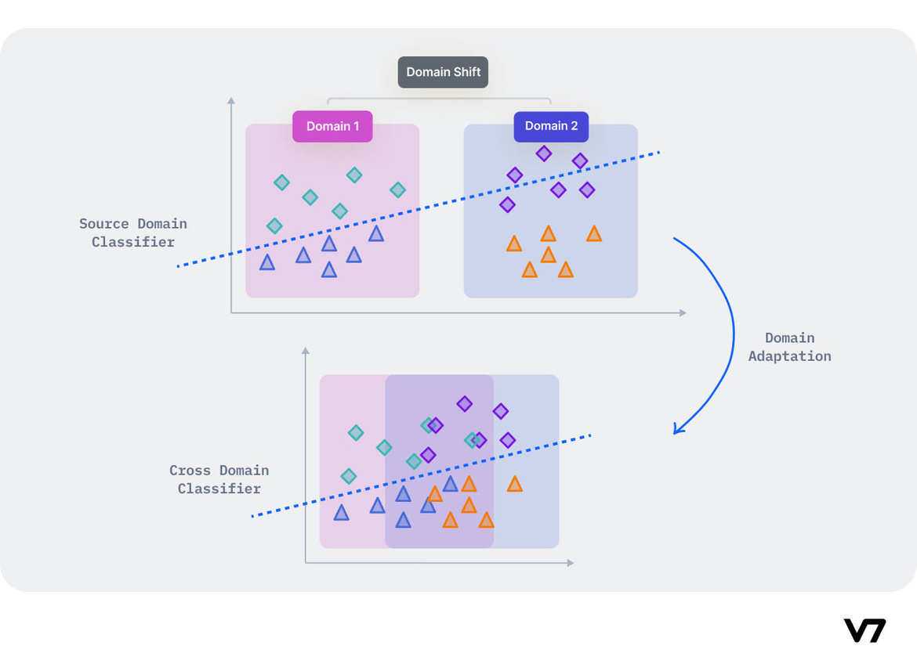
WHAT & WHY
DOMAIN ADAPTATION
Models perform well on test data only if it comes from the same data distribution as the training data.
For every new dataset -> Annotate samples -> Re-train model to adapt
DA tries to address this problem -> improve performance on target using the knowledge learned by the model from another related domain.
Computer Vision , Object Detection , Instance Segmentation , Classification
Notes:
Used in image clip extraction

Slide 7
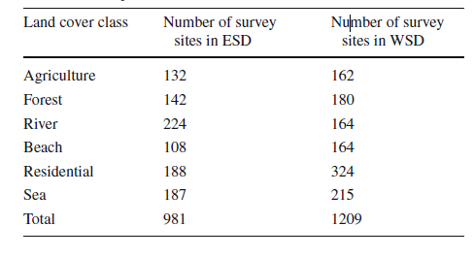
DATASET : CHARACTERISTICS
Satellite images captured over the Indian sub-continent using Google Earth Pro software [Worldview-3 & Landsat-8 satellites with 3 bands]
Identify classes devoid of the seasonal changes in the land surface.
Eastern India and Bangladesh : Eastern sub-continent (ESD) [981 survey sites]
Western India and Pakistan : Western sub-continent (WSD) [1215 Survey sites]
Res: 4800× 2791 × 3 patched to size 600 × 600 × 3 [ len * wid * band]
6 Land Cover Classes with 5 timeseries images of each site
Notes:
The mentioned points are the Objectives :

Slide 8
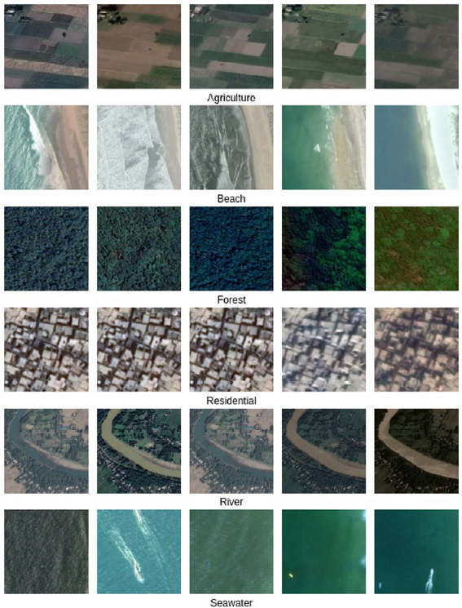
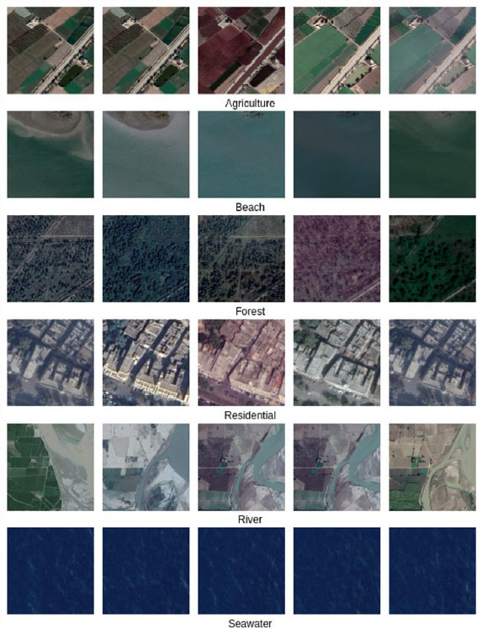

Slide 9

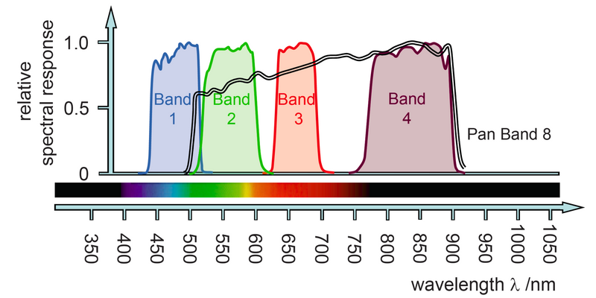
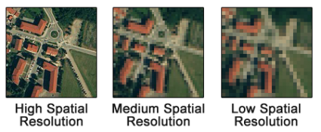
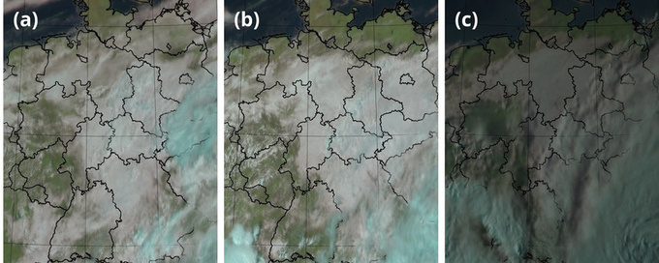
DATASET : INFORMATION GAIN
SPEACTRAL
SPATIAL
TEMPORAL
Reflected or emitted electromagnetic radiation captured by the satellite sensor across various wavelengths.
B2(Blue) B3(Green) B4(Red)
B8(Near Infra)
Arrangement of pixels within the image.
Identify shapes, sizes, and textures of land cover features.
Sharp edges -> buildings or structures
Uniform textured area -> forest canopy.
Relation of pixels in the time series frame of images.
Insights into land cover dynamics by analyzing changes in spectral reflectance and spatial disorientation over time.

Slide 10
REVEIWING SOLUTIONS FOR LCC

Slide 11
CHANNEL-BASED ATTENTION MECHANISM
Overview
Architecture expressing predictions with respect to input channels.
Relies on convolutional layers and an attention mechanism weighting the importance of each channel in the final classification decision.
DCNN architecture directly interprets its own predictions according to input channels, relying on attention mechanism, fed by features obtained from each channel through temporal convolution-based models

Slide 12
ARCHITECHTURAL SETTINGS
Reference Models
TASSEL :
1) Segmenting a reference image of the SITS and identifying the spatiotemporal clusters
2) Training a CNN on the temporal dimension to extract relevant features and then classify each object
TempCNN :
1) Different convolutional blocks applied on both the temporal and the spectral domains.
2) Spatial information is ignored
CONVOLUTIONAL BLOCKS
Channel specific : Dedicated kernels
Shared convolutions : Correlated channels grouped
Multistep feature extraction: Shared convolutions first applied on channel groups. Resulting features are then processed in a unified way by a common set of layers.
Notes:
Convolution : Mathematical operation that involves sliding a filter (also known as a kernel) over an input image or sequence of data to extract local patterns or features.

Slide 13
ARCHITECHTURAL SETTINGS
ATTENTION MECHANISM
Channel weight ai :
ai = sigmoid (< u, tanh(W*hi + b) >) for 1 <=i <= B
W , b : weights, bias of dense layer, u is a vector of parameters.
hi : Feature vectors for each band Bi
Methods of plugging
Single branch: Feeds the final classification layers with the weighted features ai*hi preserving
their dimension.
Multi branch: Multi-head with an auxiliary head trained simultaneously. Its classifier inputs are average features h = Sum(ai*hi)/B
Notes:
Features outing from the convolution block are of shape (Nfeat,B) B, the initial bands & Nfeat number of features. hi Nfeat vectors obtained from each one of the B channels.
Channel weight ai :
ai = sigmoid (< u, tanh(W*hi + b) >) for 1 <=i <= B
W and b respectively denote the weights and bias ofa dense layer, and u is a vector of parameters.

Slide 14
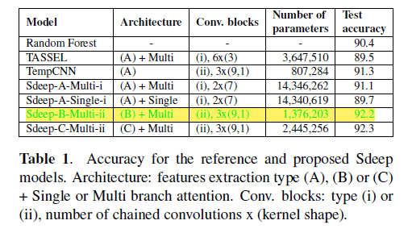
EXPERIMENTAL SETTINGS
Model (Sdeep) assessed against a classical random forest (500 trees, 200 splits), TASSEL and TempCNN.
Loss Function: Classical unweighted categorical cross entropy CE
All gradients back-propagated through an Adamgrad optimizer and an L2-regularization

Slide 15
SELF ATTENTION DEEP GRAPH CNN
OVERVIEW
Exploits the complementarity between temporal and spatial contexts.
Graphs generated from a series of temporal images, segmented into different regions
Classified using the Self-Attention Deep Graph CNN (DGCNN) model to highlight the temporal evolution of land cover areas.
Detection of land cover changes by comparing series of segmented satellite images.
Spatial temporal Deep Graph CNN based methodology
1) Detection of spatio-temporal entities (reference objects)
2) Construction of evolution graphs
3) Deep Graph CNN based classification of evolution graphs - organize and highlight objects that evolve in the same way but also evolution patterns.

Slide 16
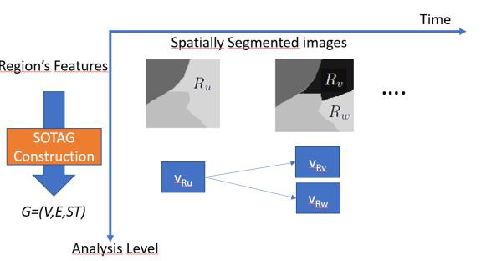
ARCHITECTURAL SETTINGS
SPATIAL-OBJECT TEMPORAL ADJACENCY GRAPHS CONSTRUCTION (SOTAG)
SITS images are carefully pretreated (pansharpening and co-registration)
Segmentation gives spatially homogenous regions.
Spatial-Object Temporal Adjacency Graph
G (V,E,ST) : Temporal evolution of regions of SITS
V : Nodes
E: Edges
ST: Multi-variate time series info
N(vi) : Neighborhood regions of node vi,
N(vi) ={vj | ∃(vi,vj)∈E}
Notes:
Pan-sharpening:
process used to enhance the spatial resolution of satellite images by combining high-resolution panchromatic (black and white) images with lower-resolution multispectral (color) images.
Co-registration:
process of aligning multiple images acquired by different sensors or at different times to ensure that corresponding pixels in different images represent the same geographic location.
Segmentation:
involves dividing an image into meaningful and homogeneous segments or regions based on certain characteristics such as color, texture, or intensity. Each segment represents a distinct object or area within the image.

Slide 17
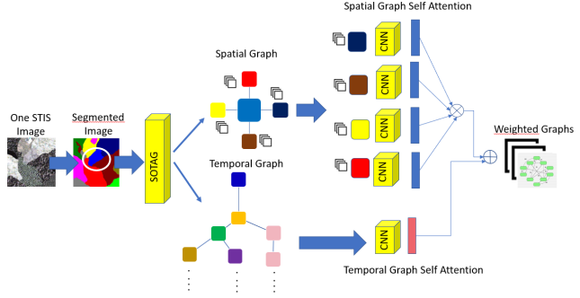
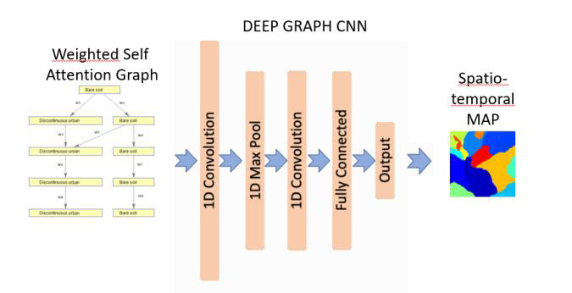
ARCHITECTURAL SETTINGS
Self-Attention Mechanism [Deep graph CNN]
Considers both spatial nodes’ features & neighboring as well as the temporal graph topology.
Processes (i) spatial information (ii) time series associated to the spatial neighborhood set.
Models the sequential information using 1-D CNN to assign weights linearly.

Slide 18
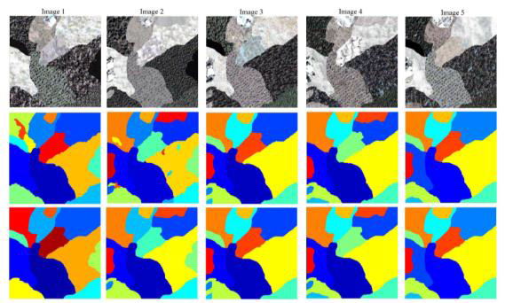
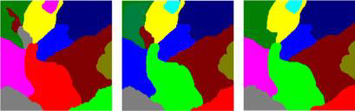
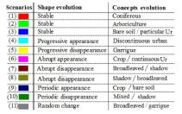
EXPERIMENTAL SETTINGS
VHR-SITS covering Zaghouan region, northern half of Tunisia
QUICKBIRD and IKONOS images
Recog 7 regions over 14 Accuracy =79.02%
kappa index = 0.705.
4 missed regions over 14 Accuracy= 86.23%
kappa index = 0.7960.
DGCNN Self-Attention DGCNN Ground truth.

Slide 19
FIRM CLASSIFICATION AND DOMAIN adaptation
OVERVIEW
Attention-based deep learning mechanism combined with the capabilities of convolutional-recurrent neural networks
Firm classification of a geographical area based on spatial & time series analysis
Develop an adaptive technique considering cross-domain multi-temporal images
Attention Mech : Important Visual Techniques
Conv- LSTM : Exploits Temporal Dependencies
Major Challenges addressed
Apt labeled source data but severe scarcity of same in target domain
Difference in class distribution limits use of source data for target domain model training
Domain Adaptation :
Classifier made adaptive to generalize further over target domain data using domain neutralizer network to reduce difference in cross-domain feature distribution

Slide 20
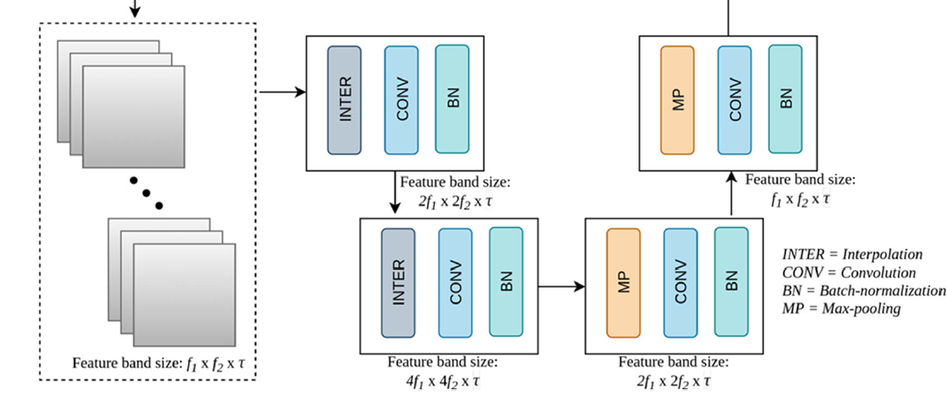
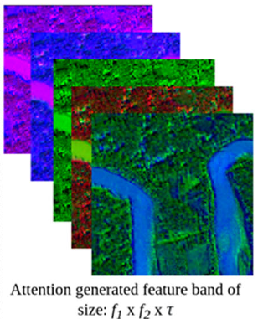
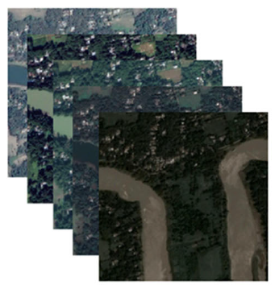
METHODOLOGY & ARCHITECTURE
DOMAIN NEUTRALIZATION
Attention Mech captures distinct land-class from the input image
Corresponding pixels focused.
LSTM captures focused info from each time series image.
The effect of any irrelevant info other than the most significant ones are diminished, alleviating the need for building a fresh training set through manual processes while classifying the test (multi-temporal) images belonging to a disparate region.
Attention Block
Notes:
During the up-sampling process, a
simple duplication of pixel intensity values is applied to the
neighbouring pixels to scale up the image to a factor dependent
on the scale by which the image is to be magnified. On
the contrary, the down-sampling process involves the application
of a max-pooling operation (Goodfellow et al. 2016)
over the image where the size of the filter is determined by
the scaling factor.

Slide 21
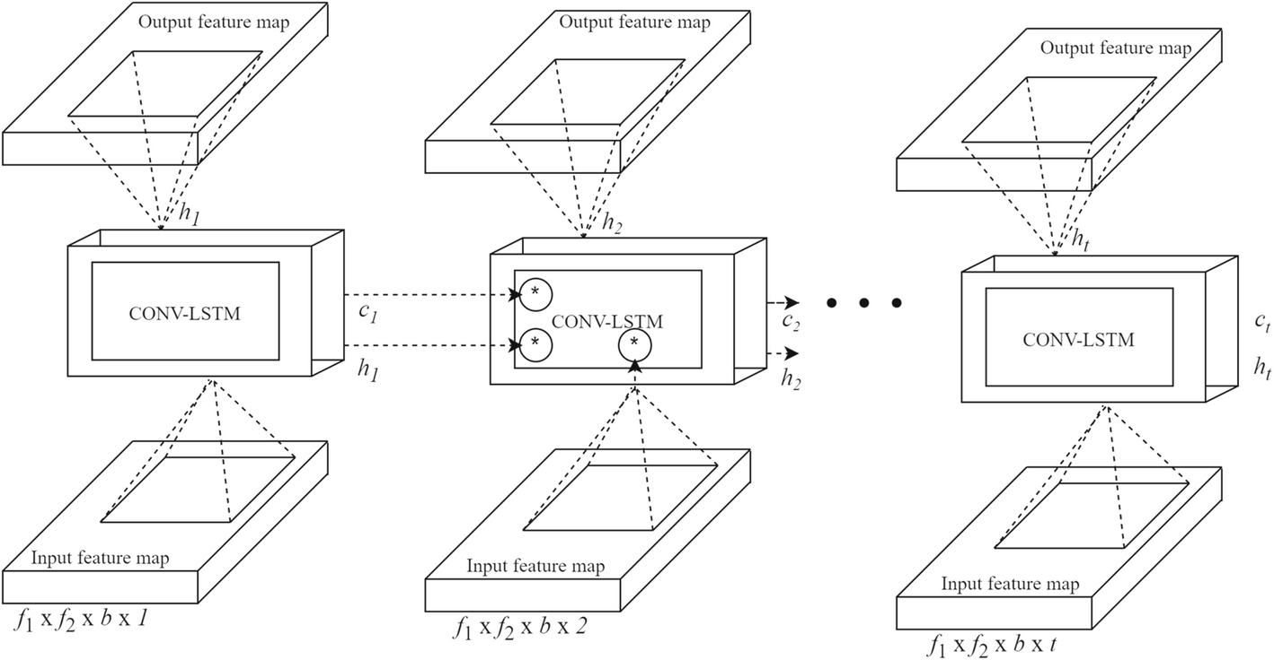
ARCHITECTURE SETTINGS
CONV-LSTM
Input : Temporal maps F1, F2, ...Ft [ f1 × f2 × b ] 3D Tensor image
Each cell p processes input & passes cp to the consecutive cell (processed info)
Outputs: h1, ..., ht . [Feature Maps]
Notes:
The RNN, specifically,
the long short termmemory (LSTM) neural network, utilized
here has a special capability to solve the vanishing gradient
problems inherent in the traditional RNNs (Goodfellow et al.
2016). An LSTM is a special type of neural network which
contains multiple cells each corresponding to capture a temporal
entity of the input. Each of the LSTM cells contain one
memory cell (represented here as ct ) and three essential gates
like input (as it ), forget (as ft ) and output (as ot ) gates.

Slide 22
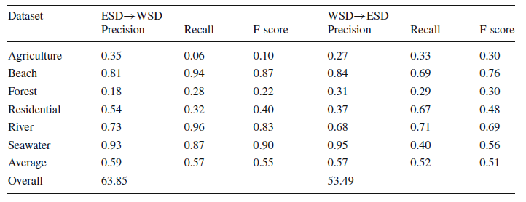
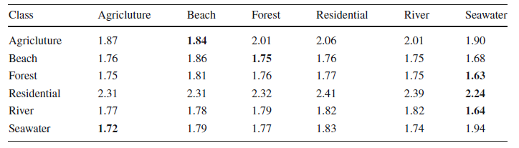
EXPERIMENTAL SETTINGS & RESULTS
Time-series images of each site stacked to form tensors [ l*w*3*5 ]
Outputs 15 feature bands [5*3]
KL Divergence : low inter-class and high intra-class distribution divergence among source & target dom.
Hyperparameters :
Learning Rate [0.1-0.0001], Epochs[50-2000], Mini Batch Size [200-3000]
KL Divergence without DA
Performance Eval on common Feature space
Notes:
Kullback-Leibler divergence, is a metric used to measure the difference between two probability distributions.
Range [0,inf]

Slide 23
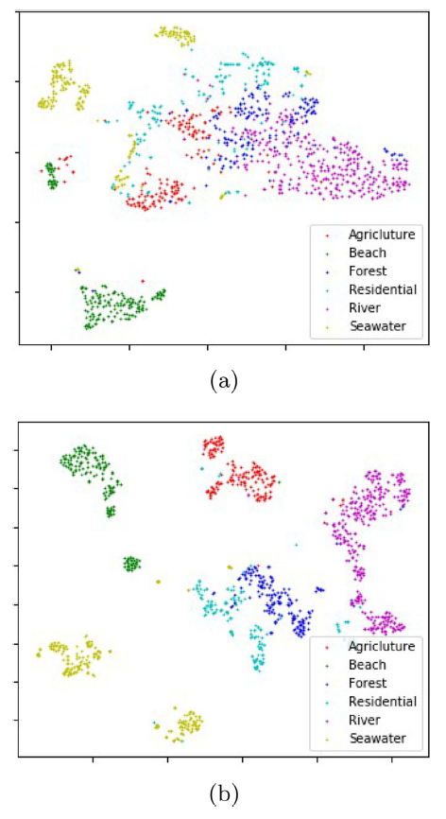
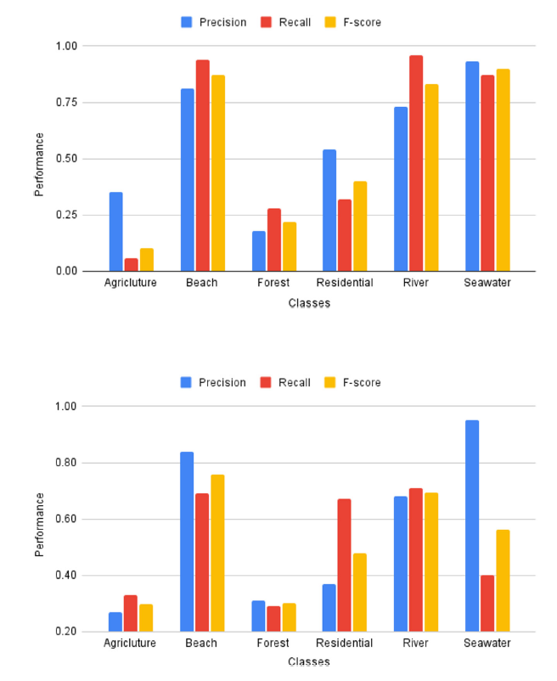
RESULTS
Class Wise Bar Graphs (a)ESD->WSD (b)WSD->ESD
Scatter plots (a) Without DA (b) WIth DA

Slide 24
CONCLUSIONS
Improved Accuracy: Learning complex, non-linear relationships within the data.
Effective Use of Multi-Temporal Data: Analyzing spectral and spatial variations across time
Data Scarcity Impact: Significantly reduces the need for extensive data collection and annotation
Generalizability: To unseen data from new geographic locations.
CHALLENGES
Computational Cost: Access to powerful computing resources is crucial.
Data Requirements: Good Quality Data and extremely careful preprocessing
DA Performance : Substantially lower compared to the efforts

Slide 25
PLAN OF ACTION
ADVERSARIAL Learning and spatially-aware Self-Training
Domain Adversarial NN -> adversarial learning with the aim to extract domain invariant features
Transfers the underlying classification model from source to target domain via self-training
1-DCNN as backbone for attention
Self Training. What & how it helps ?
Semi-supervised : Training Iteratively assigning pseudo-labels.
Training Coupled Neural Networks that concurrently predict the class labels of each sample image.
The prediction agreed by all the neural networks is considered as the final label

Slide 26
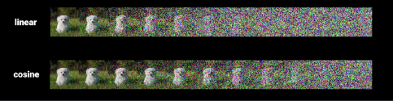

DIFFUSION MODEL
Generative models
Capable of beating GANs on image synthesis
Forward/Diffusion Process
systematically and slowly
destroy structure in a data distribution through
an iterative forward diffusion process.
Reverse diffusion process
Restores structure in data, yielding a highly flexible and tractable generative model of the data.
Training the model using variational inference involves complex calculations for probability distributions. It aims to find the exact parameters of the Markov chain that match the observed (known or actual) data after a specific time.
Architecture :
Conditional Diffusion Models: These models incorporate an additional label conditioning term during the diffusion process. This term guides the model towards denoising the data while considering the desired land cover class information.
Auxiliary CNN Classifier :

Slide 27
References
Channel-Based Attention for Land Cover Classification using Sentinel-2 Time Series | IEEE Conference Publication | IEEE Xplore
Self Attention Deep Graph CNN Classification of Times Series Images for Land Cover Monitoring | IEEE Conference Publication | IEEE Xplore
Temporal-Domain Adaptation for Satellite Image Time-Series Land-Cover Mapping With Adversarial Learning and Spatially Aware Self-Training | IEEE Journals & Magazine | IEEE Xplore
A deep learning-based technique for firm classification and domain adaptation in land cover classification using time-series aerial images

Slide 28
THANK YOU

